Slide 1
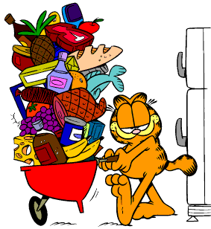
FOOD
5th and 7th grade

Slide 2


Meals and meal time
The Great Britain X the Czech Republic
Breakfast
Snack
Lunch
Snack
Dinner

Slide 3
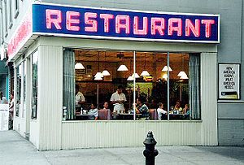
At a restaurant
How to order something
Can I offer you something to drink?
What would you like to eat?
I´ll have…..
We´ll pay for it.

Slide 4
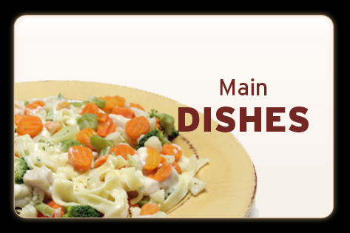
British menu
Main courses Chicken salad ………… ₤5.80 Fish and chips ………… ₤5.15 Cottage pie ……………. ₤4.65 Pizza ………………….. ₤4.60 Spaghetti bolonese…….. ₤4.20 All-day brekfast ………. ₤4.10 (bacon, egg, sausages, mushrooms and tomatoes) Jacket potato with: tuna ……………..₤3.99 cheese …………..₤3.75 butter ……………₤3.25 Peas ……………………... 65p Beans ……………………. 65p Salad ……………………. 80p

Slide 5
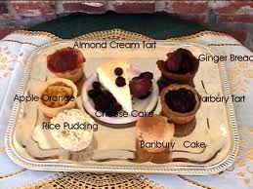

British menu
Desserts Apple pie with ice-cream .. ₤2.75 Sticky toffee puding …….. ₤2.70 Chocolate cake ………….. ₤2.60 Fruit salad ………………...₤2.40 Ice-cream………………… 95p Drinks Orange juice ………………₤1.30 Lemonade ………………… 80p Cola ………………………. 80p Milk ………………………. 75p Coffee …………………….. 90p Tea ………………………... 80p Hot chocolate ………………. 95p

Slide 6

What you like X What don´t you like

Slide 7
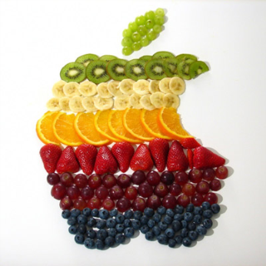
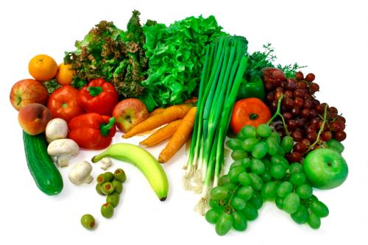
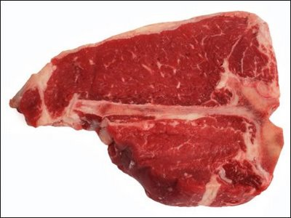
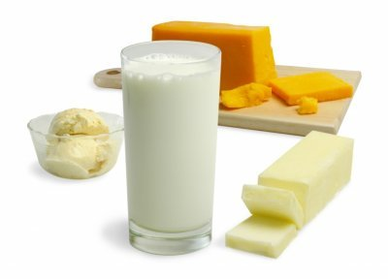
What is it?
Fruit
Vegetable
Meat
Dairy product

Slide 8
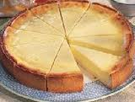
Recipe – Sweet cheese pie
Ingrediences:
300g of flour
3/4 l of milk
1 small egg
3 yolks
3/4kg of sweet chesse
2 vanilla puddings
335g of sugar
2dcl of oil
130g of butter
1 small spoon of baker soda

Slide 9
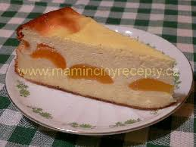
Recipe – Sweet cheese pie
Procedure:
Mix the flour and baker soda. Add butter, 135g of sugar, an egg and three yolks.
Ready mixture put into a tray.
Filling : Two ready vanilla puddings (two vanilla pudings+ 3/4l of milk) let it cool down and stire sweet cheese, add 200g of sugar and 2dcl of oil.
Mix mixture with cold pudding and coat the baked pie with it.
Enjoy it!

Slide 10
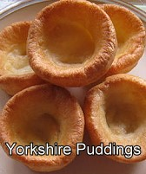
Recipe – Yorkshire Pudding
Ingrediences:
1 cup of plain flour
1 cup of eggs
1 cup of milk
salt

Slide 11
Recipe – Yorkshire Pudding
Procedure:
Preheat the oven to hot (210 degrees).
Put a tea spoon of oil in each of several muffins and place in the oven until the fat is hot and beginning to smoke. Combine the rest of the ingredients and beat to form a batter of the consistence of double cream.
If you wish you can add mixed dried herbs to add a savoury flavour.
When the fat is smoking take the tin out of the oven and place it over a low light so that it doesn´t cool as you add the batter.
Pour in the batter if you are using muffin tins don´t over fill.
Remember that the puddings will rise and puff up.
Put the tin back into the top of the oven as soonn as possible and leave for about 20-25 mins.
Enjoy it!

Slide 12

Stone Soup
A story about a smart tramp and a mean old woman…..
What did the tramp put into the soup???

Slide 13
Thanks for attention

