Slide 1
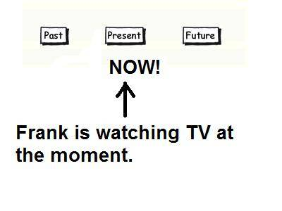
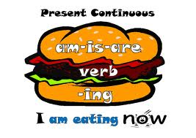
PRESENT CONTINUOUS
PŘÍTOMNÝ ČAS PRŮBĚHOVÝ

Slide 2

Právě teď něco děláme …

Slide 3

Právě teď něco neděláme …
They are not swimming.

Slide 4
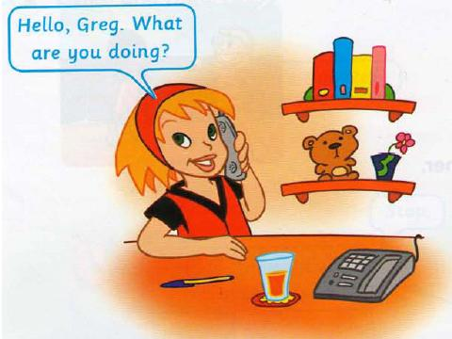
Ptáme se, co právě děláme …

Slide 5
Exercise 1
Put the verbs into present continuous.
My sister ……………………. (to clean) the bathroom.
Look! …………………………They (to go) inside.
I ………………………..(to wait) in the car now.
Mrs Miller ………………………….(to listen) to CDs.
We ……………………………(to speak) English at the moment.

Slide 6
Exercise 1 - key
Put the verbs into present continuous.
My sister is cleaning the bathroom.
Look! They are going inside.
I am waiting in the car now.
Mrs Miller is listening to CDs.
We are speaking English at the moment.

Slide 7
Exercise 2
Rewrite the sentences using the negative forms.
We are playing a game. …………………………………………..
I'm drawing a picture. ……………………………………………….
He is making pizza right now. ………………………………….
Susan and her brother are taking photos. ………………..
Dad is working in the kitchen. …………………………………….

Slide 8
Exercise 2 - key
Rewrite the sentences using the negative forms.
We are not playing a game.
I'm not drawing a picture.
He is not making pizza right now.
Susan and her brother are not taking photos.
Dad is not working in the kitchen.

Slide 9
Exercise 3
Write questions in present continuous.
Robin / to ride / his bike - …………………………………..
where / she / to go - ……………………………………………
what / your mother / to do / now - ……………………..

Slide 10
Exercise 3 - key
Write questions in present continuous.
Robin / to ride / his bike – Is Robin riding his bike?
where / she / to go – Where is she going?
what / your mother / to do / now – What is your mother
doing now?

Slide 11
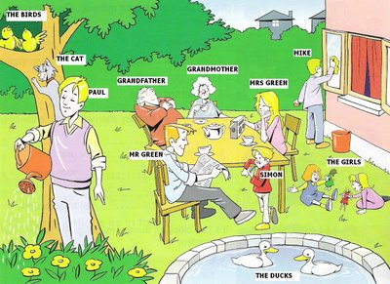
Homework – Describe the picture and use Present Continuous

