Slide 1
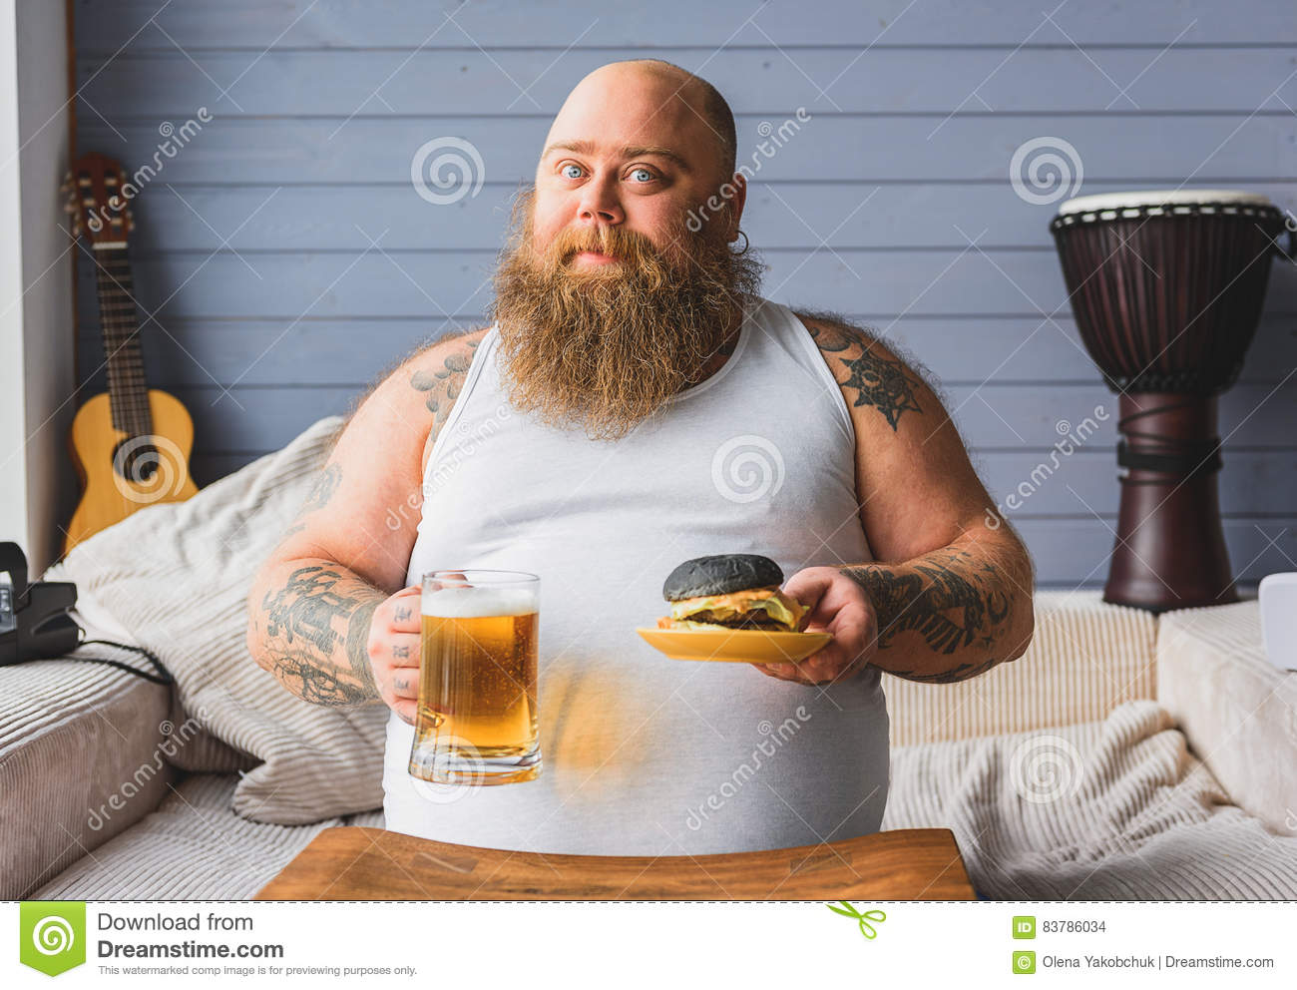
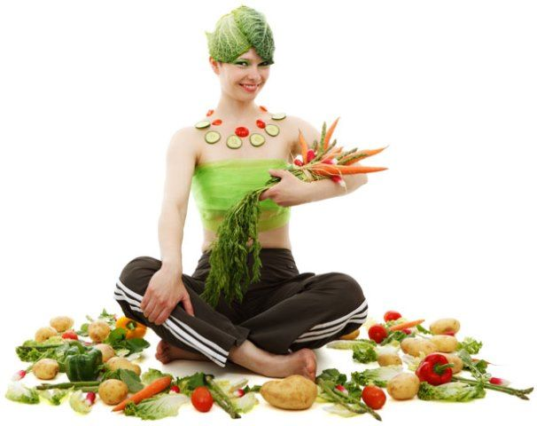
What are we going to talk about?
What do you see in the pictures?
Describe your lifestyle in a few sentences – what you eat/drink, how often you exercise?

Slide 2
Sources:
Vegetable lady - https://pxhere.com/en/photo/1250157
Burger man – https://www.dreamstime.com/search.php?securitycheck=19785d7903c681520c93f4e371d9a613&firstvalue=&lastsearchvalue=&srh_field=burger+man&s_all=y&s_ph=y&s_il=y&s_video=y&s_audio=y

